Slide 1
TELECOM CLIENT CHURN FORECAST USING MACHINE LEARNING
Chukwuemeka Okoli
7th January, 2022

Slide 2
OUTLINE
Executive Summary
Introduction
Methodology
Results
Conclusion
Appendix

Slide 3
EXECUTIVE SUMMARY
Summary of methodologies
- Open the data and study the general information
- Data Preprocessing
- Exploratory Data Analysis
- Modeling Process
- Model Training
- Model Analysis
- Model Testing
Summary of all results
- Exploratory Data Analysis result
- Predictive Analytics result

Slide 4
INTRODUCTION
Project background and context
Interconnect telecom would like to be able to forecast their churn of clients. If it's discovered that a user is planning to leave, they will be offered promotional codes and special plan options. Interconnect's marketing team has collected some of their clientele's personal data, including information about their plans and contracts.
Project Objectives
- Build a machine learning model to forecast Interconnect telecom's client churn
- Apply exploratory data analysis in determining whether special promotional services and plan options will discourage client churn
- Analyze the speed and quality of prediction, time required for training, etc.
TELECOM CLIENT CHURN FORECAST USING MACHINE LEARNING

Slide 5
Section 1
Methodology

Slide 6
OPEN THE DATA AND STUDY THE GENERAL INFORMATION
The data consists of files obtained from different sources. By looking at the data, we find that:
- “contract_data” has 7043 rows and 8 columns with no missing values and no duplicated values.
- “internet_data” has 5517 rows and 8 columns with no missing values and no duplicated values.
- “personal_data” has 7043 rows and 5 columns with no missing values and no duplicated values.
- “phone_data” has 6361 rows and 2 columns with no missing values and no duplicated values.

Slide 7
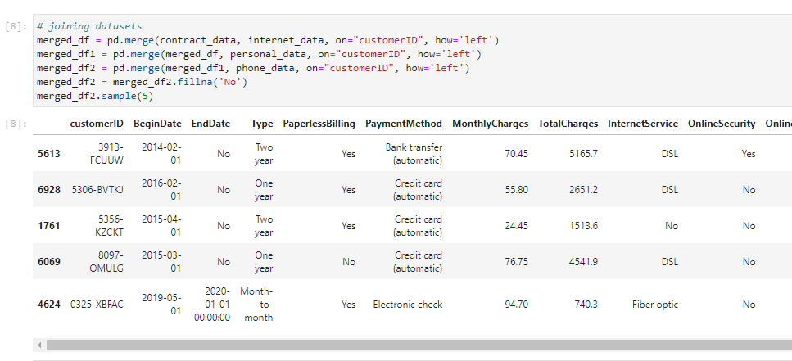
DATA Preprocessing
We merged the four dataset using the SQL-flavored merging in pandas
We replace column names and change data types
We performed feature engineering to create “dayofweek”, “month”, “tenure”
TELECOM CLIENT CHURN FORECAST USING MACHINE LEARNING

Slide 8
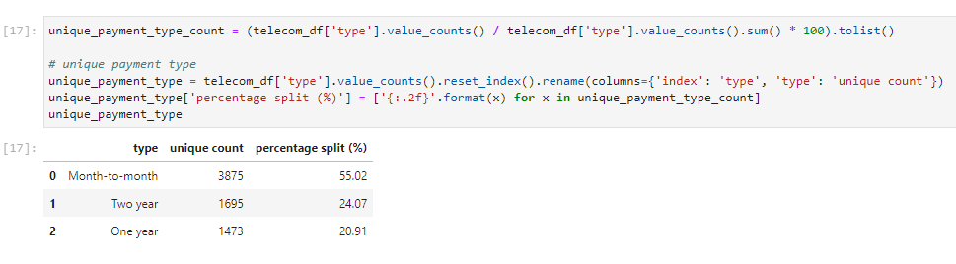
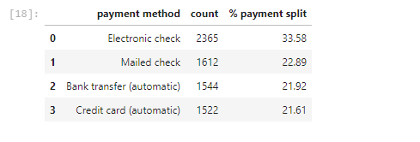
EXPLORATORY DATA ANALYSIS
We explored the data in order to generate insights from it.
We tried to find out what payment type is unique to Interconnect’s customers
We determined the payment methods that are unique to customer’s
TELECOM CLIENT CHURN FORECAST USING MACHINE LEARNING

Slide 9
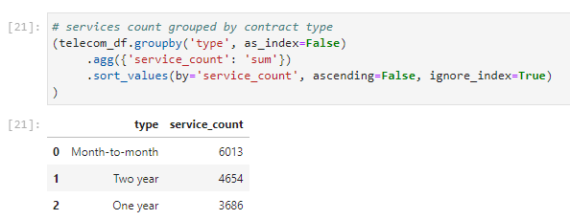
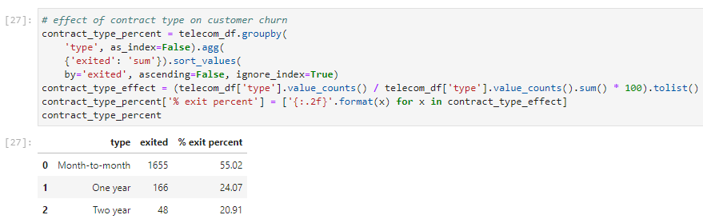
EXPLORATORY DATA ANALYSIS
We determined the services count by contract type
We determined if contract type affect customer churn
TELECOM CLIENT CHURN FORECAST USING MACHINE LEARNING

Slide 10
INSIGHTS FROM EDA
Section 2

Slide 11
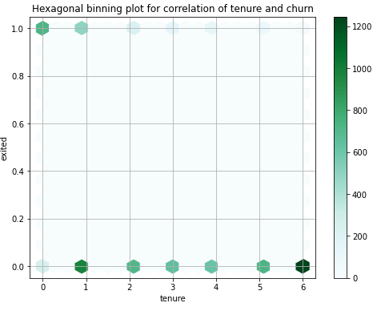
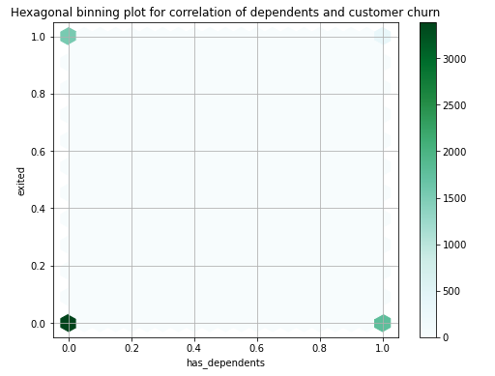
EXPLORATORY DATA ANALYSIS
Customers with less tenure are more likely to churn than well-established customers
Customers without dependents stayed longer with Interconnect telecoms than customers with dependent. It would make sense for Interconnect to target customers with less dependents.
TELECOM CLIENT CHURN FORECAST USING MACHINE LEARNING

Slide 12
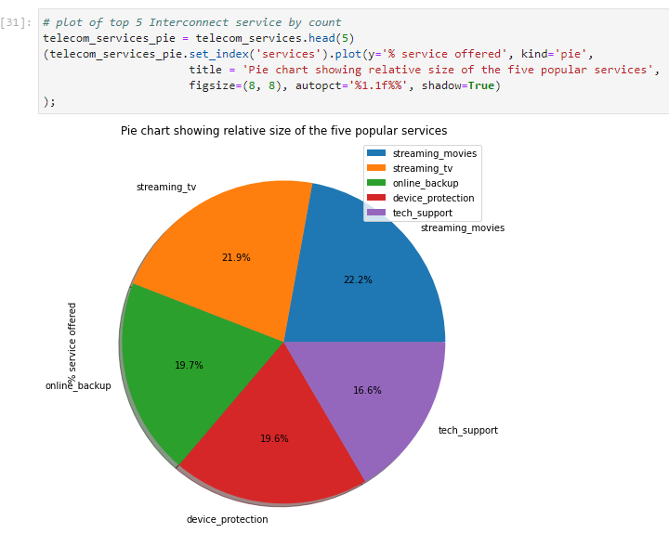
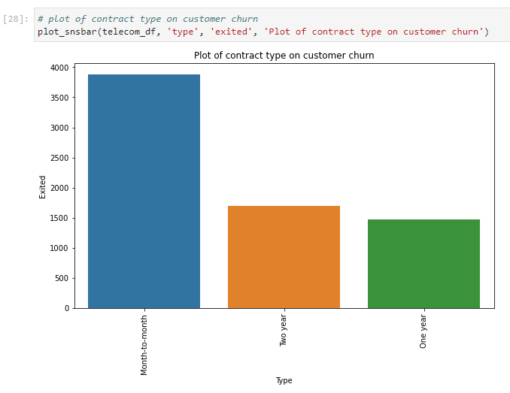
EXPLORATORY DATA ANALYSIS
Customers with two-year long contract tends to stay longer while customers on a month-to-month contract type churned faster.
The top 5 services offered are streaming movies, streaming tv, online backup, device protection and tech support.
TELECOM CLIENT CHURN FORECAST USING MACHINE LEARNING

Slide 13
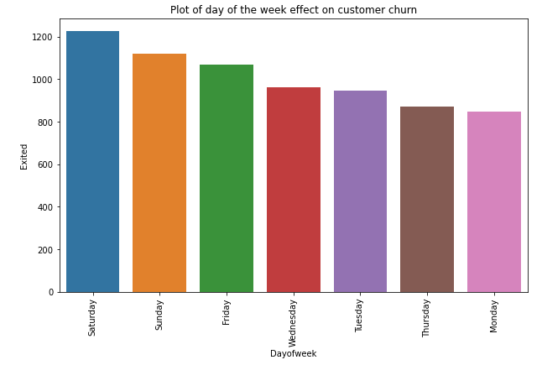
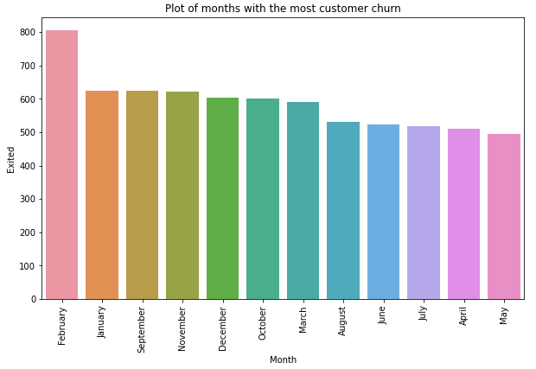
EXPLORATORY DATA ANALYSIS
Most churn occurred during the weekend.
The months of February, September, November and December had the most churn.
TELECOM CLIENT CHURN FORECAST USING MACHINE LEARNING

Slide 14
INSIGHTS FROM EDA
Most customers prefer month-to-month payment.
Customers on a two-year contract bring in more revenue and churn less.
Most churn occurs at weekend.
Customers using more than 4 services churn less than others.
Action plan:
Targeted marketing campaigns and promotional events should be done to promote the two-year plan to Interconnects customers.
Encourage customers to make payment using electronic check.
Introduce several bonuses, free service offerings for six months starting from September to February to prevent churn.
Introduce special end of the week promotional events and services.
TELECOM CLIENT CHURN FORECAST USING MACHINE LEARNING

Slide 15
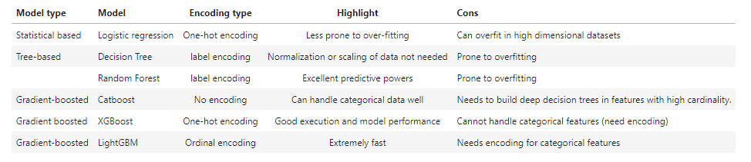
MODELING PROCESS
The primary metric we used to evaluate the model is AUC-ROC. The secondary metric is accuracy.
We performed feature engineering and encoded categorical variables using either one-hot encoding, label encoding or ordinal encoding.
We split data into 75% training and 25% testing set
We scaled the data by applying the standard scaler function
We developed a baseline model
TELECOM CLIENT CHURN FORECAST USING MACHINE LEARNING

Slide 16
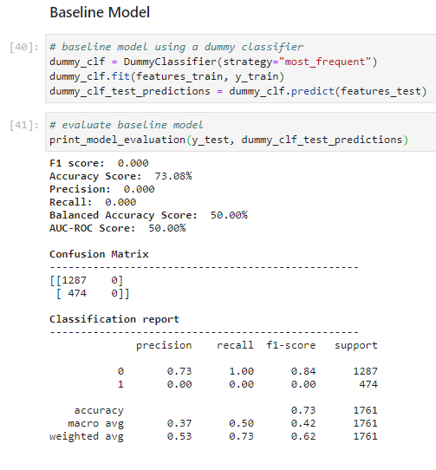
MODELING PROCESS
We developed a baseline model with accuracy of 73% and AUC-ROC score of 50%. This represents the baseline, so we expect our models to perform better.
TELECOM CLIENT CHURN FORECAST USING MACHINE LEARNING

Slide 17
MODEL TRAINING
We tuned hyperparameters for each model and cross validation during sampling of data for machine learning.
We choose the best performing models on the training accuracy and AUC-ROC metric
We also plotted the feature importance for each models
We trained six models and chose the best performing model.
The XGBoost classifier was the best performing model with a score of 91.3% on the training set.
The XGBoost classifier was chosen as the model for the final testing on the test data because of its low hyperparameter tuning time, low prediction time and high accuracy.
TELECOM CLIENT CHURN FORECAST USING MACHINE LEARNING

Slide 18
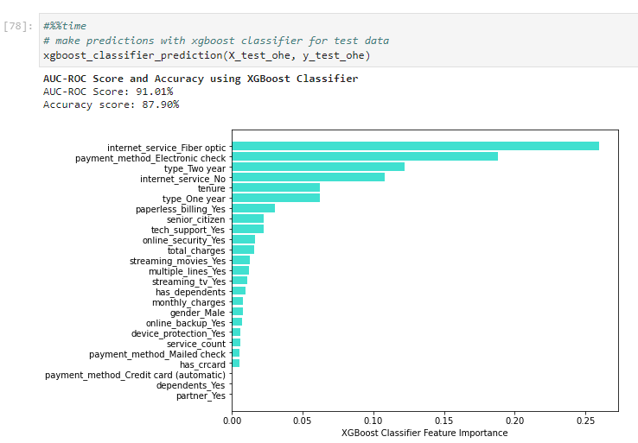
Model testing
TELECOM CLIENT CHURN FORECAST USING MACHINE LEARNING

Slide 19
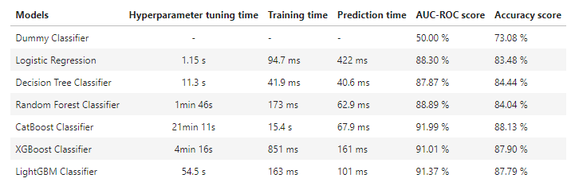
Summary of results
TELECOM CLIENT CHURN FORECAST USING MACHINE LEARNING

Slide 20
CONCLUSION
We built a machine learning solution to forecast Interconnect telecom’s client churn.
We applied exploratory data analysis in determining whether special promotional services and plan option will discourage client churn.
We analyzed the speed and quality of prediction, time required to train and prediction accuracy.
TELECOM CLIENT CHURN FORECAST USING MACHINE LEARNING

Slide 21
THANK YOU
Chukwuemeka Okoli
TELECOM CLIENT CHURN FORECAST USING MACHINE LEARNING

